Slide 1
Understanding Clouds from Satellite Images
Understanding Clouds from Satellite Images
Understanding Clouds from Satellite Images
Understanding Clouds From Satellite Images
Sprint 2
Team 1
Notes:
Hi everyone, this is a presentation of the sprint 2 of our project which is named “Understanding Clouds from satellite images”. In this presentation, we’ll go over the most updated architecture of our projects and explain the main modules we’ve completed. And, state some important decisions we’ve make in this sprint or for the next sprint.

Slide 2
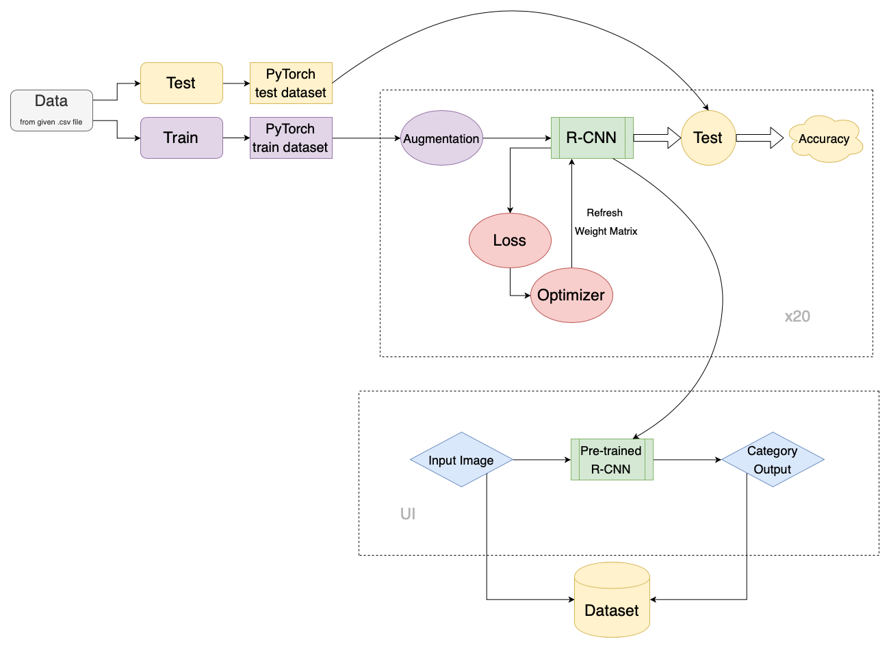
Notes:
Here is the most updated architecture of our project. And our sprint 2 has already completed these two parts.
Here is the data preprocess part, here is the augmentation, and here is the train module.
The pre-trained RCNN will be used later in this project.

Slide 3
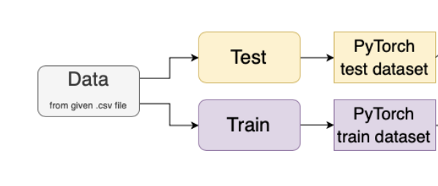
Data Preprocess
Split test and train data from given .csv file
Transfer to PyTorch datasets
Prepare for data augmentation
Notes:
At the very beginning of the project, we should preprocess the data set. We splite the test and train data set and transform them from the given csv file to Pytorch dataset format.

Slide 4
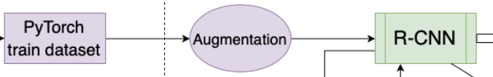
Augmentations: Albumantation
flexible API that allows that library to be used in any computer vision pipeline
its easy integration with PyTorch
Based on numpy, OpenCV, imgaug picking the best from each of them
Notes:
The next step is to do the data augmentation, which is necessary to increase the size of train dataset.
To do so, the library we use is called albumentation. Since, its simple, flexible API that allows that library to be used in any computer vision pipeline and, also, its easy integration with PyTorch makes it suitable to our project.

Slide 5
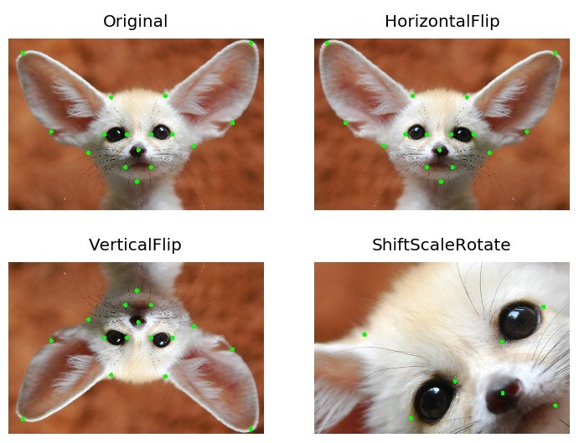
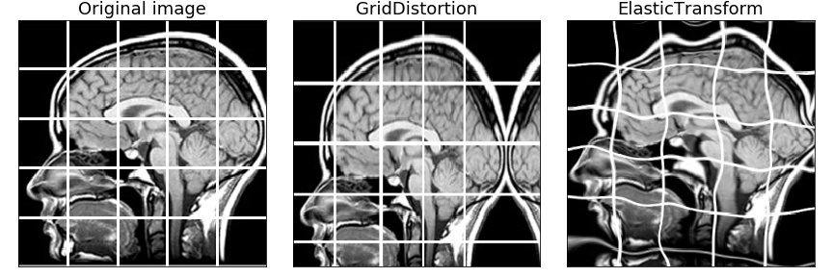
Augmentations
Horizontal flip
Vertical flip
Random rotate
Elastic transform
Grid distortion
Optical distortion
Notes:
We applied 6 different transformations on the original dataset and increase the size of dataset to 10 times of its original size.
In our project, augmentations we used includes like horizontal flip, vertical flip, random rotate, elastic transform, grid distortion and optical distortion.
The basic idea of these transformations:
1.horizontal flip is to flip the image horizontally
2.vertical flip is to flip the image vertically
3.random rotate is too apply a rotate by a random degree on the image
4.elastic transform is to randomly set a standard deviation of the interval of (-1,1) for each dimension of the pixel, and the Gaussian filter is used to filter the deviation matrix of each dimension.
5. and we chose to do two another distortions: grid and optical.

Slide 6
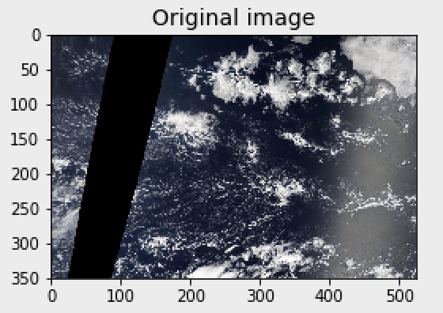
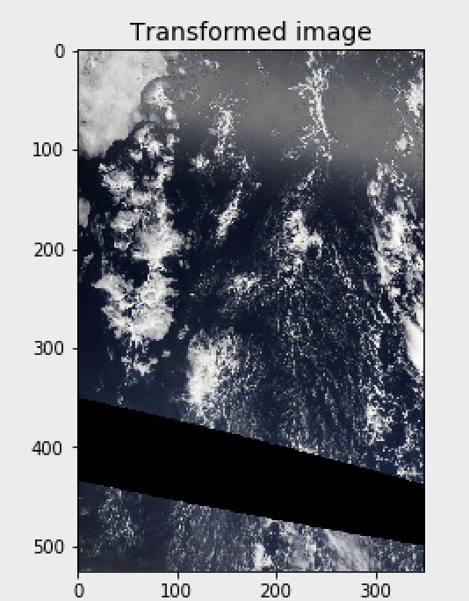
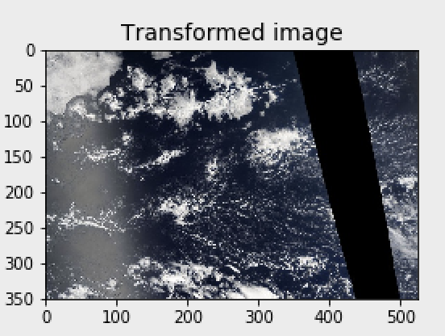
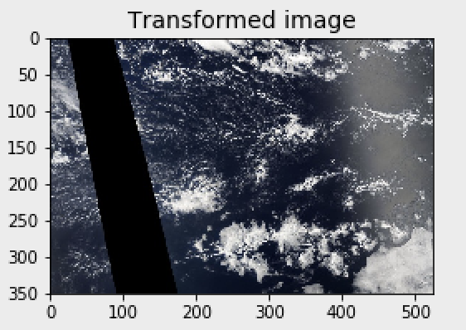
Demo
Horizontal flip
Vertical flip
Random rotate 90

Slide 7
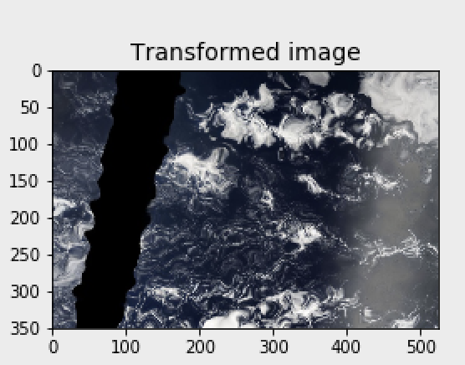
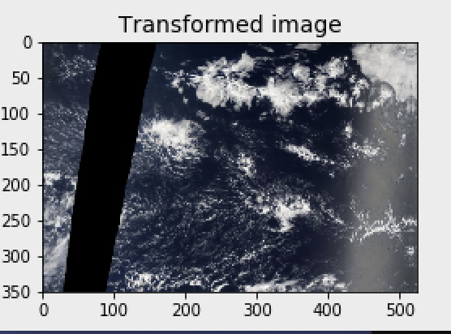
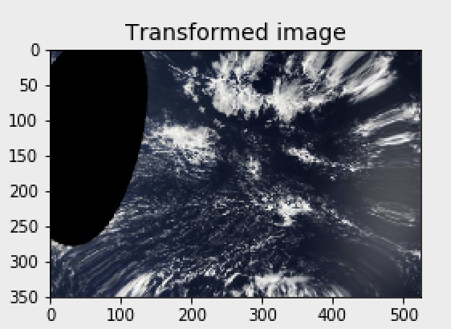
Demo
Elastic Distortion
Grid Distortion
Optical Distortion

Slide 8
Make a dataset format that meets the dataloader input requirements
put all the augmented data into the R-CNN train module
Next..
Notes:
The next step is to make a dataset format that meets the dataloader input requirements, and put all the preprocessed data into the train dataset. By doing so, the size of our train dataset increases at least 6 times, and it is helpful to get a more accurate train result when we feed it to our train module.

Slide 9
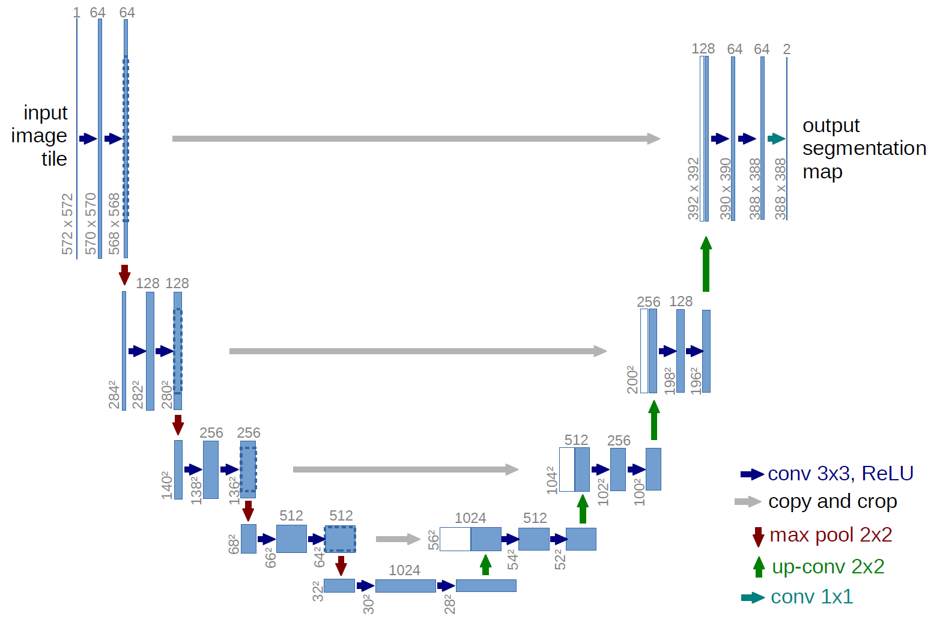
R-CNN: U-net
U-Net is a convolutional neural network that was developed for biomedical image segmentation.
High accuracy given proper training, adequate dataset and training time.
This architecture is input image size agnostic.
Leads to smaller model weight size
Can be easily scaled to have multiple classes;
Code samples are abundant.
Notes:
Regions with CNN features

Slide 10
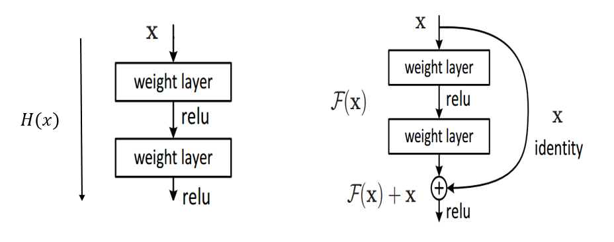
ResNet-50
Instead of widen the network, increasing depth of the network results in less extra parameters
Reducing the effect of Vanishing Gradient Problem
Leads to smaller model weight size on same level of accuracy
Obtaining higher accuracy in network performance especially in Image Classification

Slide 11
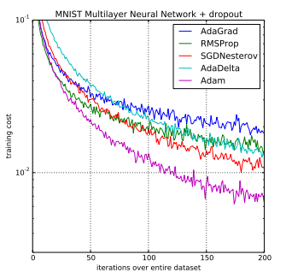
Optimizer
optimizer = optim.Adam([var1, var2], lr=0.0001)
Adam is a replacement optimization algorithm for stochastic gradient descent for training deep learning models.
Adam combines the best properties of the AdaGrad and RMSProp algorithms to provide an optimization algorithm that can handle sparse gradients on noisy problems.
Adam is relatively easy to configure where the default configuration parameters do well on most problems.
Notes:
Models often benefit from reducing the learning rate by a factor of 2-10 once learning stagnates. This callback monitors a quantity and if no improvement is seen for a 'patience' number of epochs, the learning rate is reduced.

Slide 12
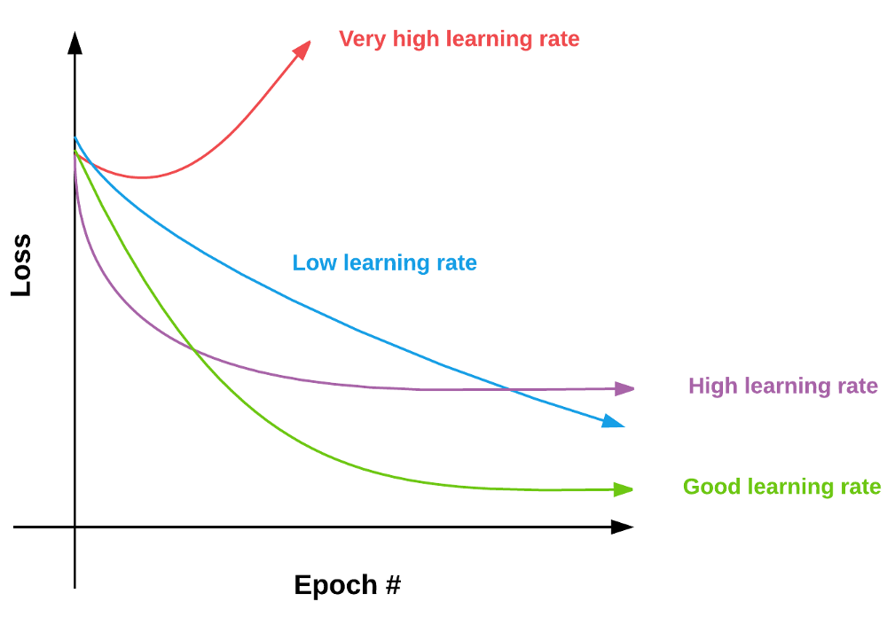
Learning rate scheduler
keras.callbacks.callbacks.ReduceLROnPlateau(monitor='val_loss', factor=0.1, patience=10, verbose=0, mode='auto', min_delta=0.0001, cooldown=0, min_lr=0)
Reduce learning rate when a metric has stopped improving.
Notes:
Models often benefit from reducing the learning rate by a factor of 2-10 once learning stagnates. This callback monitors a quantity and if no improvement is seen for a 'patience' number of epochs, the learning rate is reduced.

Slide 13
What We Got So Far

Slide 14
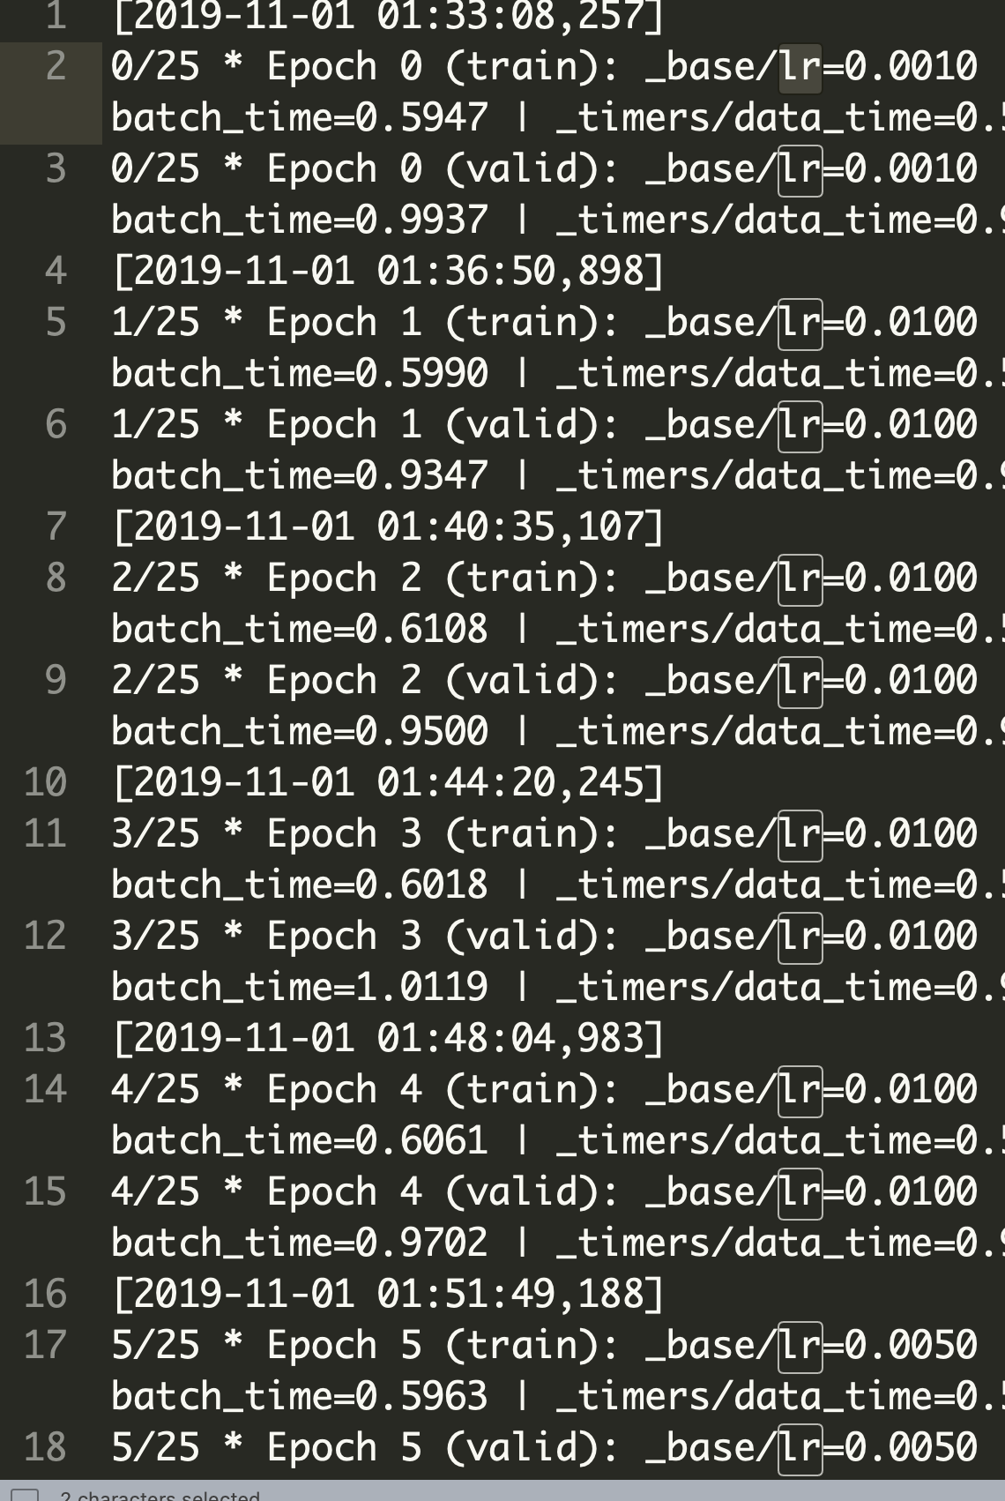
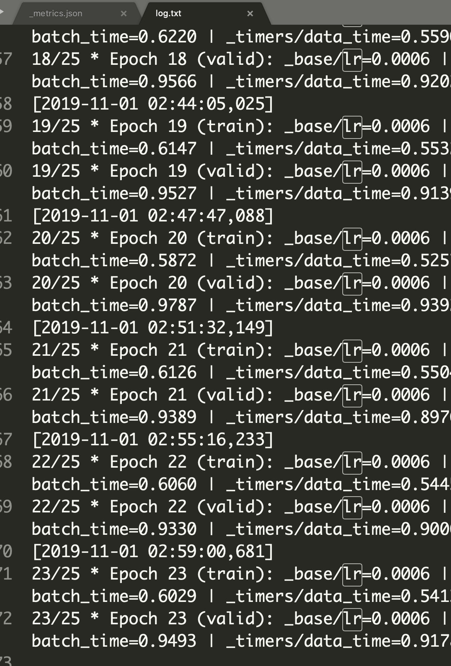
Training Log
Learning rate is
changing...

Slide 15
An Output
Image_Label,EncodedPixels
002f507.jpg_Fish,
002f507.jpg_Flower,
002f507.jpg_Gravel,358 332 705 341 1054 344 1403 345 1753 346 2103 346 2453 346 2803 346 3153 346 3502 347 3852 347 4202 347 4552 347 4902 347 5252 348 5602 348 5952 348 6302 348 6652 348 7002 348 7352 348 7702 348 8052 348 8402 348 8752 348 9102 348 9452 348 9802 348 10152 348 10502 348 10852 348 11202 348 ….
002f507.jpg_Sugar,113525 3 113873 7 113887 5 114220 11 114235 11 114568 28 114917 30 115266 31 115615 31 115964 13 115979 16 116313 8 116330 14 116659 12 116679 15 117008 35 117356 36 117415 6 117705 37 117765 11 118054 37 118115 11 118404 37 118464 12 118753 39 118813 13 119103 39 119161 16 …..

Slide 16
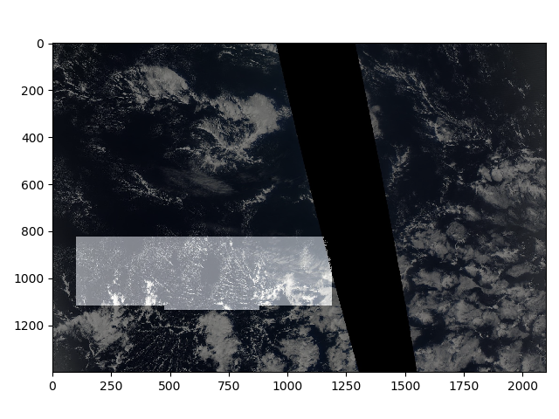

Slide 17
Plan for the Sprint 3

Slide 18
Improve the Kernel
Compare the output accuracy of different network frames, different NN backbones...

Slide 19
Reusable NN
Store the final weight matrix (weights and thresholds) of the pre-trained NN.
Current status: use segmentation models with pretrained backbones (PyTorch)
Next step: keep the model and load the matrix (may build up our own packages…)
Notes:
Pretrainedmodels.models.torchvision_models
https://github.com/qubvel/segmentation_models.pytorch

Slide 20
Look-up Index
Database and GUI.
Store images and their categories.
Upload the image, get masks and cloud types.

